Slide 1


Vilnius good practices in waste management
Anton Nikitin
Chief Sustainability Officer
City of Vilnius

Slide 2
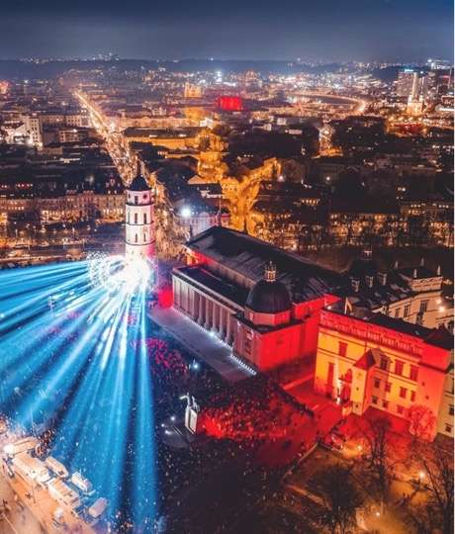

One of the fastest growing cities in the region & economies in the EU with 600,000+ residents
EU net zero mission city
A city of happy citizens with 98% happy to live in Vilnius
61% of Vilnius is covered in green
European Green Capital 2025

Slide 3
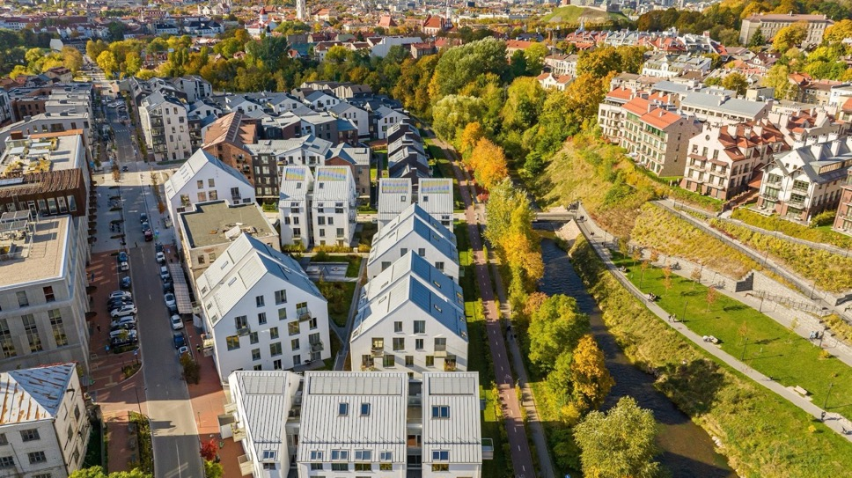

We’re not the
Greenest city. Yet.

Slide 4
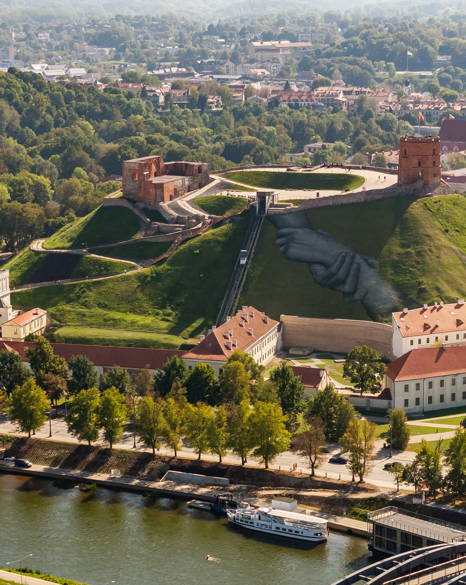
Waste management in a nutshell
Vilnius creates 400kt of solid waste daily
328 kg of waste generated per person yearly, 29% recycled
In 2016 Lithuania started deposit system for bottles
In 2024 Vilnius started to collect food waste separately

Slide 5
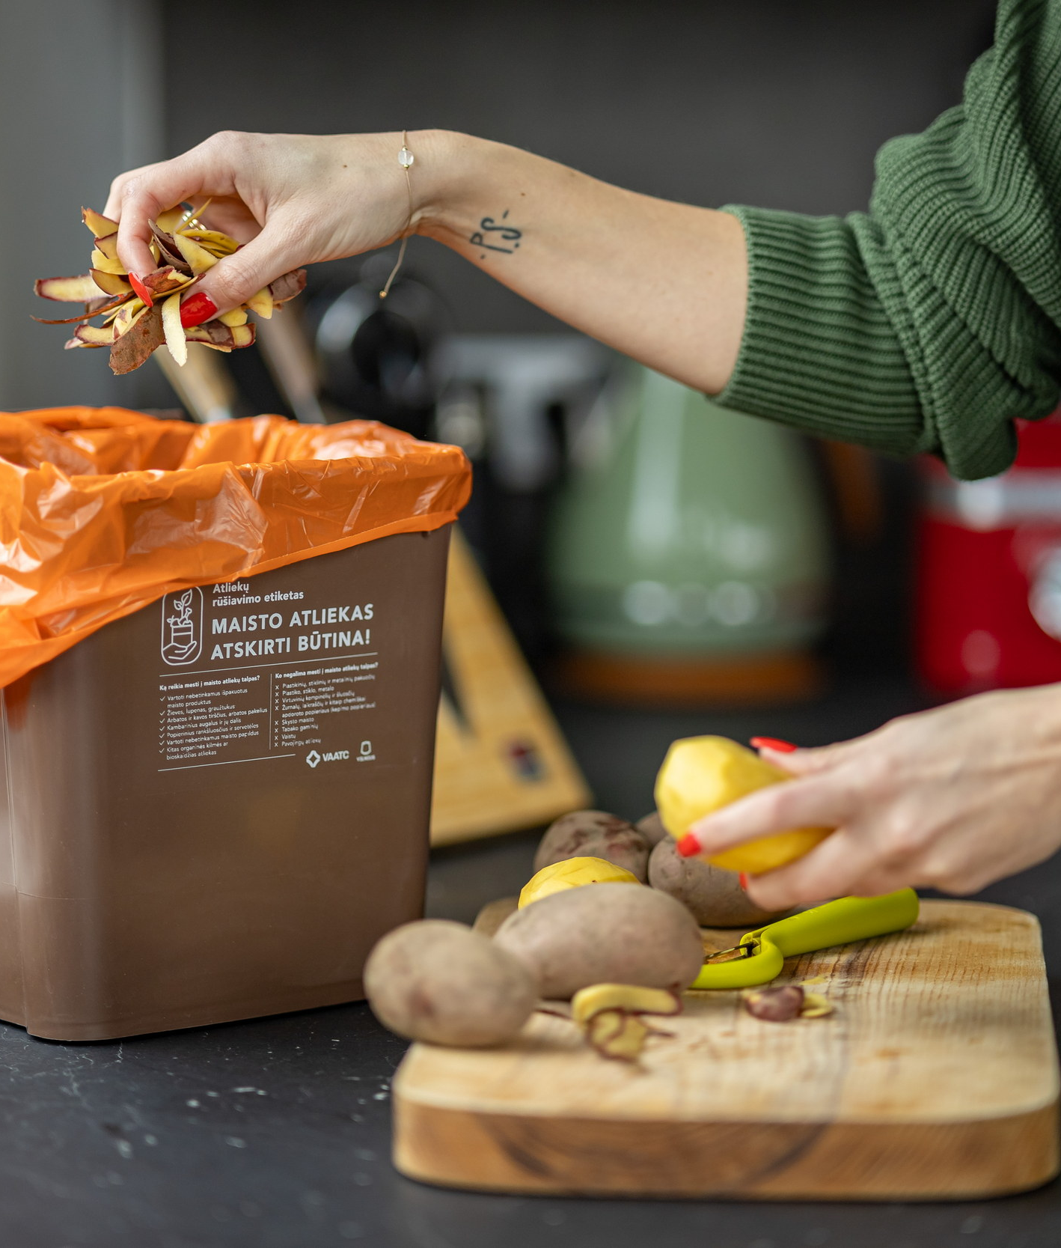
General waste sorting & recycling
Vilnius is increasing part of sorted waste / from 21% in 2020 to 29% in 2024.
Secondary sorting happens in MBT facility. Around 14% of plastic is additionally sorted from general waste.
Only 2kt of food waste sorted in 2024. However, measurable impact on MBT efficiency and recycling potential

Slide 6
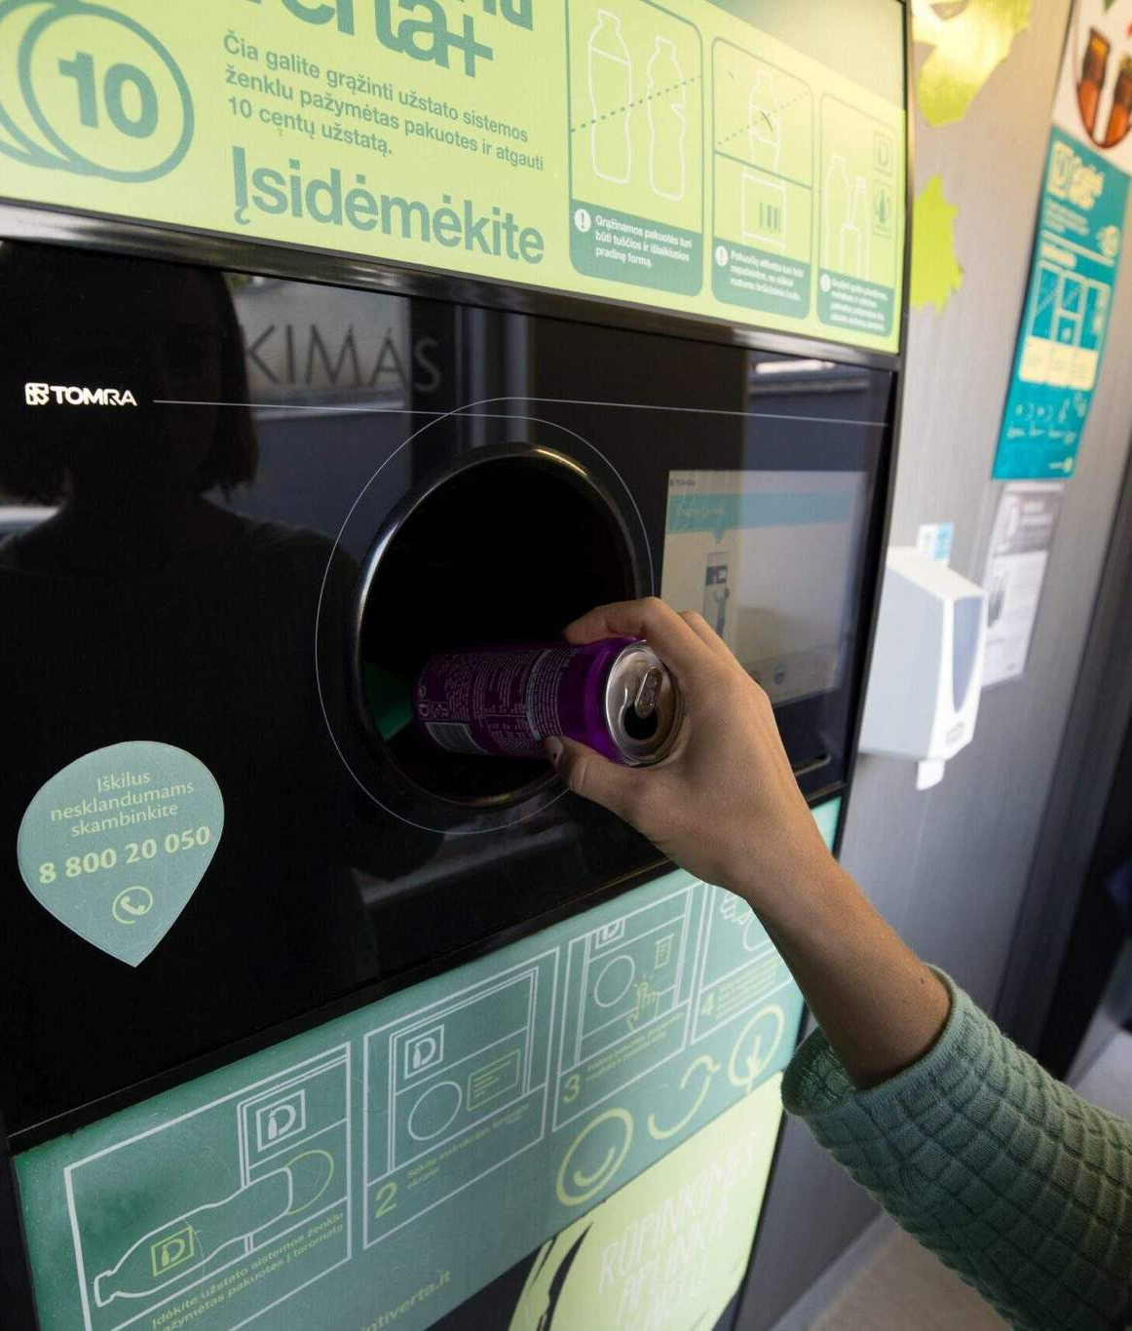
Deposit system success
National level system deployed in 2016 – 0,1 Eur is deposited when purchasing drinks (in metal, glass or plastic bottles).
Before introduction, 33% of single-use beverage packaging was recycled. After – 92%
As of 2024, PET collected in the system is to be recycled to rPET.

Slide 7
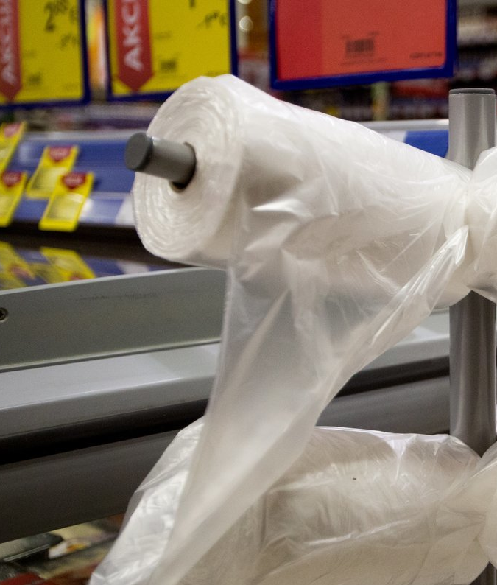
Small change – price on lightweight plastic bags
Since 2021 as of National legislation, grocery stores introduced a 1 ct fare per single use lightweight plastic bag
According to shopping centers' data, the reduction of usage of these bags is approx. 50-60%
Estimation of Ministry of Environment is that this decision reduced usage of these bags 4x

Slide 8
Greetings from Vilnius. The greenest city in the making.
Anton Nikitin
Vilnius Chief Sustainability Officer

